Slide 1

Divvy Van Assistant
Presenters: Alfonso Arias, Juan Zambrano, Vivek Ganesan

Slide 2
Description

Slide 3

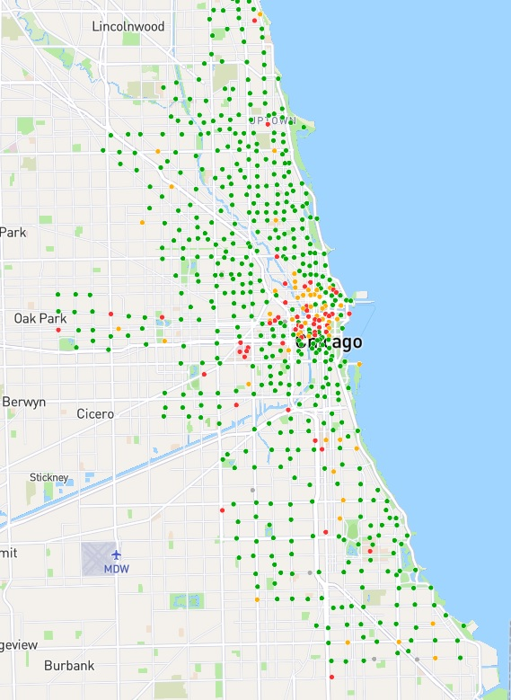
Divvy Van Assistant
Based on Divvy Share Ride, operated by Motivate
Deliver bikes, scooters efficiently
Managing any necessary maintenance work
All in a well-ordered and timely manner

Slide 4
Use Cases

Slide 5
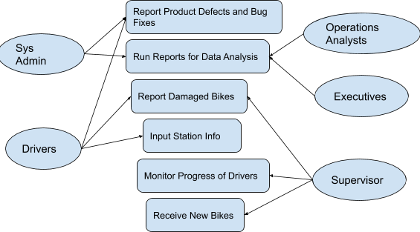
Use Case Diagram

Slide 6
Requirements

Slide 7
Functional Requirements
Data
Performance
Dependability
Maintainability & Support
Security
Usability & Humanity

Slide 8
Data & Performance
Station Count:
Description: The system must be able to keep track of the number of bikes at each Divvy station in real time.
Rationale: The system will use this information for its algorithm to determine which station to transfer bikes.
Fit Criterion: This requirement is met when the number of bikes at each station after transfer hours is appropriate for ridership levels.
Acceptance: #6
Notes:
DATA

Slide 9

Data & Performance
Map Data
Description: The system must use an API to keep track of the map location of the city of Chicago.
Rationale: The system will try to determine the most efficient route from one station to the next while trying to eliminate the challenges of left turns and lane changes. Therefore, a map is needed when determining the route.
Fit Criterion: The map will be implemented in the UI interface so the driver will be able to keep track of routes in real time. The driver will also get traffic updates so the route will change in the event of a major incident.
Acceptance: #7
Notes:
DATA

Slide 10

Data & Performance
Loading the Application:
Description: The application must take no longer than one full minute to load.
Rationale: Speed of opening an application is needed so that the software does not slow down daily operations.
Fit Criterion: When the amount of time it takes to load the desktop application is less than one minute, the loading of the application is optimal.
Acceptance: #9
Notes:
Performance

Slide 11
Design

Slide 12
Design Goals
The main system will be integrating a map based API onto the system.
Essential that the system integrate the map as efficiently as possible without creating any lag.
Speed of the map and the speed of the algorithm processing time is essential.
The system must also not occupy more than 2 GB of memory.
Essential that the system not occupy too much memory where it slows down other operations of the computer.
The system must have an easy User Interface for the user.
The Driver is able to understand the UI of the application.

Slide 13
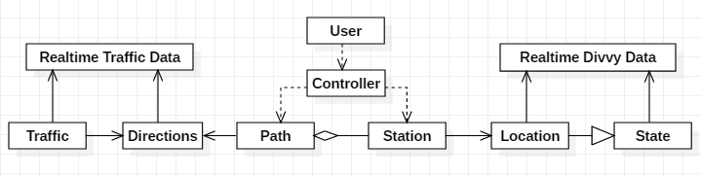
UML Diagram
*Realtime data is key, 2 database sources

Slide 14
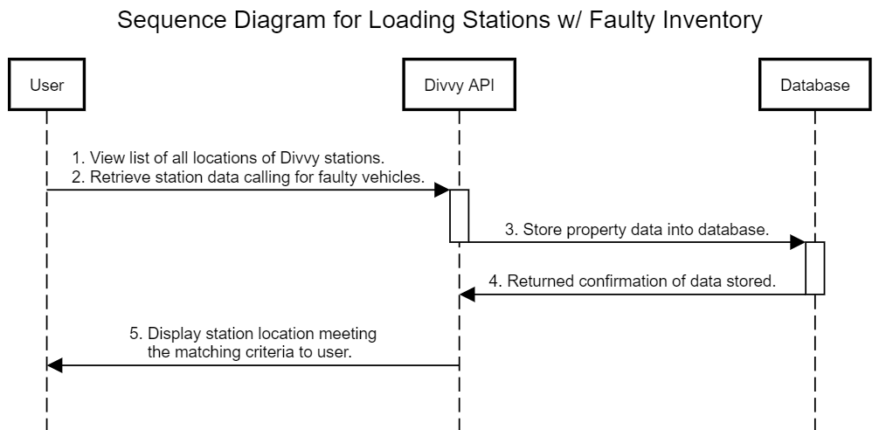
Sequence Diagram
Use case: The user [driver] retrieves locations containing vehicles in need of repairs.

Slide 15
Issues

Slide 16
Open Issues
How does the system account for road closures? If a Divvy station is located on the street of a closed construction site, how will the algorithm know to ignore that station for the time being?
How does the system reconfigure to account for bikes that are not returned properly?
How does the data produced by the system properly integrate and account for the revenue, expenses, and profit of the system?
How does the system account for weather delays, traffic disruptions, and other issues related to routing?

Slide 17
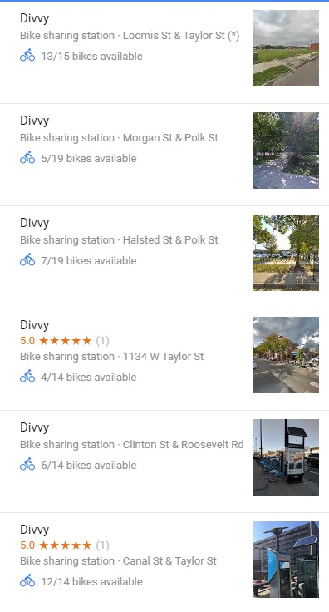
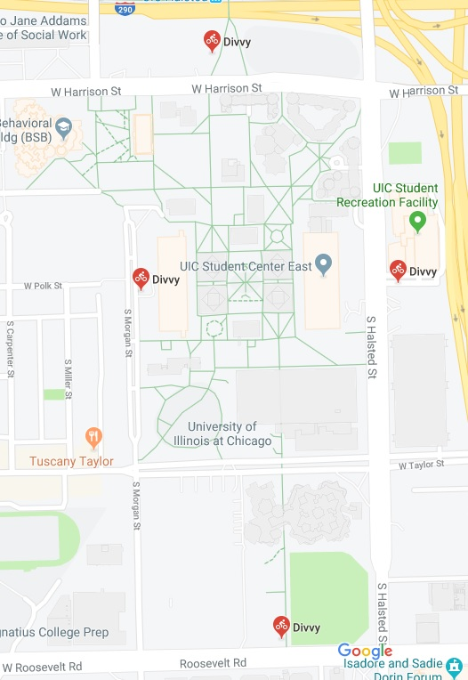
Ready Made Product
Google Maps Partners with Divvy
location of each Divvy station in the given area
The number of bikes per-station
Successful in 24 cities, including Chicago
Currently lacks a “Ride Plan”
Doesn’t automatically select the route between station to station.
https://chicago.curbed.com/2019/7/22/20703908/divvy-stations-google-maps-app
https://blog.google/products/maps/real-time-bikeshare-information-google-map/

Slide 18
Thank You

